Slide 1


Intro to n8n
The Orchestrator: Workflow Automation & AI

Slide 2


Class Objectives
•
Fundamentals: What is n8n, why use it, and the concept of "The Orchestrator".
•
Interface: Navigating Nodes, Edges, and Executions.
•
Data: Understanding JSON and why we use it.
Goal
•
AI Integration: Using AI Agents, Tools, and Output Parsers.
To understand the full ecosystem of n8n.
•
Resources: Certification, Docs, and Pricing.

Slide 3





Table of Contents
01 Introduction & Setup
02 The Core Concepts
What is n8n & The Orchestrator No-Code vs. Low-Code Pricing, Trial & Self-Hosted
Interface Tour (Canvas, Sidebar) Nodes, Edges & Workflows Triggers vs. Actions Executions & Credentials
03 Data & JSON
04 AI Integration
Saving Workflows (.json) JSON Structure (Keys, Arrays, Objects) Using Templates
AI Agent Node & Models Tools & Capabilities Output Parsers & Logic Chat Interface Node
05 Resources & Support
Level 1 Course Certification Official Documentation Community Forums

Slide 4

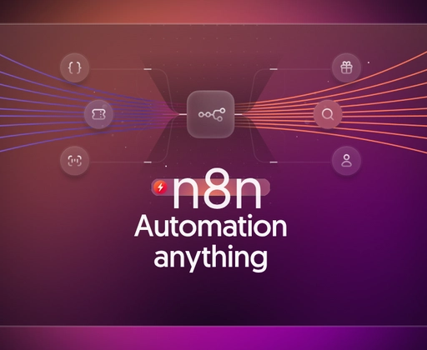

What is n8n?
Definition
n8n is a workflow automation tool.
It allows you to connect anything to everything. You can link Google Sheets to OpenAI, or Slack to email, without writing complex code.
It is "Fair-code" (source available) and can be self-hosted or run in the cloud.

Slide 5






Why use n8n?
The Orchestrator
Visibility
Flexibility
Instead of apps talking randomly to each other (Spaghetti Code), n8n sits in the middle and manages the flow of data.
You can see exactly where data goes. If an error happens, you see exactly which node failed.
It connects to 200+ built-in apps, but also any API via HTTP Request.

Slide 6

No-Code vs. Low-Code
The Spectrum
n8n sits in the "sweet spot" between simplicity and power.
•
No-Code: Drag and drop nodes. Select "Gmail" and click "Send". No programming needed.
Accessible to beginners.
Powerful for developers.
•
Low-Code: When you need complex logic, you can write small snippets of JavaScript or Python directly inside the nodes.

Slide 7



Pricing & Plans
Starter
Free Trial
Self-Hosted
14 Days
$24/mo
Free
Full feature access to test the platform.
1,000 Executions
Host it on your own server.
Great for individuals and small automations.
Requires technical maintenance.

Slide 8


Concept: Workflows
The Container
A Workflow is the complete automation script.
•
It consists of Nodes and Edges.
•
It can be active (running automatically) or inactive.
JSON Representation
•
You can organize them with Tags.
Every workflow is actually just a big JSON text file. This makes them easy to share.
Think of a workflow as a single "Robot" dedicated to one job.

Slide 9


Concept: Nodes & Edges
Nodes (Steps)
Edges (Wires)
On Click
The dots on the board. Each node performs an action (Get Data, Send Data, Process Data).
The lines connecting nodes. They define the flow of execution and pass data from left to right.
You can trigger nodes manually. The "Execute Node" button allows you to test just one step at a time.

Slide 10
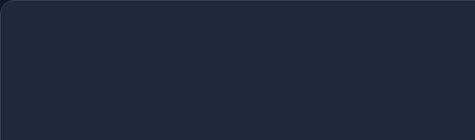

Concept: Triggers
Starting the Engine
Every workflow needs a Trigger Node to start.
•
App Trigger: "When a new row is added to Sheets".
•
Schedule Trigger: "Every morning at 9 AM".
•
Webhook Trigger: "When a URL is visited".
•
Manual Trigger: "When I click 'Test Workflow'".

Slide 11




Executions & Credentials
Executions
Credentials
The history log. Shows every time the workflow ran.
Where you store API Keys and Passwords.
•
Green: Success.
Stored securely and separated from the workflow logic so you don't accidentally share your passwords.
•
Red: Error.
Vital for debugging errors.

Slide 12

Saving Workflow as JSON
Portability
You can "Download" or "Copy" your entire workflow.
It saves as a .json file.
Why?
•
Backups: Save versions of your work.
•
Sharing: Send your automation to a friend.
•
Migration: Move from Cloud to Self-Hosted.

Slide 13



What is JSON?
JavaScript Object Notation
It is the standard format for data on the web.
Key-Value Pairs
Objects { }
Arrays [ ]
"name": "John"
Curly braces hold a single item.
Square brackets hold a list of items.
A label and a value.

Slide 14
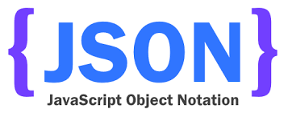
Why JSON?
The Universal Language
Computers need a standard way to talk.
•
Lightweight: Uses very little memory.
•
Readable: Humans can read it (unlike binary).
•
Supported Everywhere: Every modern API (Google, OpenAI, Slack) speaks JSON.

Slide 15
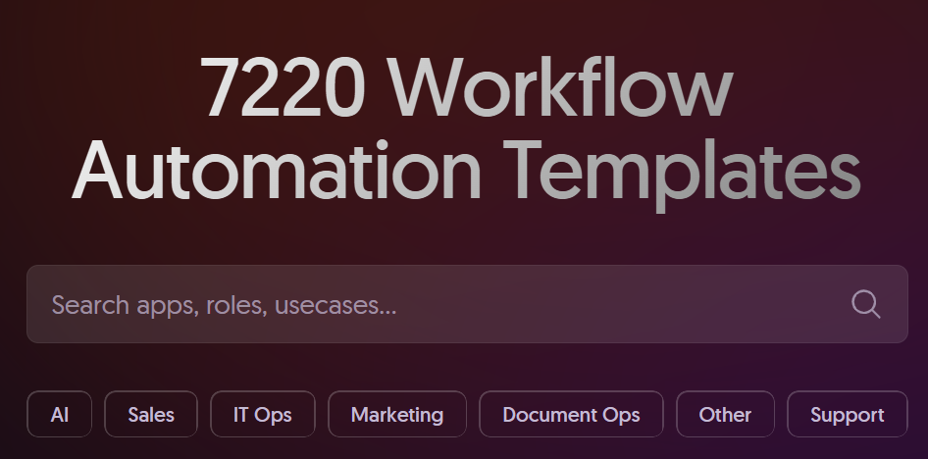

Templates
Cheat Sheets
n8n provides a library of pre-built workflows.
Use Cases:
•
"Sync HubSpot to Slack"
•
"Summarize News with AI"
Don't build from scratch. Search the templates, copy the JSON, and paste it into your canvas.

Slide 16

n8n AI Features
Agents, Models, and Parsers

Slide 17

The AI Agent Node
The Brain
This is a special node that connects to an LLM (Like GPT-4).
It is not just a chatbot; it can reason and use tools.
Inputs:
•
User Query: What you ask it.
•
Context: Information from previous nodes.

Slide 18




Agent Components: Model & Tool
The Model
The Tool
The engine that does the thinking.
Abilities you give the AI.
•
OpenAI (GPT-4o)
The AI cannot browse the web or check your calendar unless you attach a specific "Tool" node to it.
•
Anthropic (Claude 3.5)
•
Mistral / Llama

Slide 19

Why Output Parser is "Needy"
The Problem
AI speaks English (Unstructured).
Computers speak JSON (Structured).
The Solution
If you ask AI for a list, it might say:
"Sure! Here is your list: 1. Apple, 2. Banana"
The Output Parser forces the AI to reply in strict JSON format so the rest of your workflow doesn't crash.
This breaks automation because the next node expects:
["Apple", "Banana"]

Slide 20
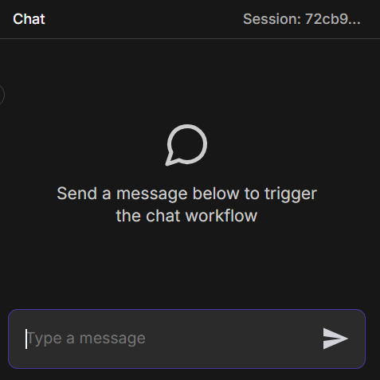
The Chat Node
Interactive Interface
Normally, workflows run in the background.
The Chat Trigger allows you to build a chat interface (like ChatGPT) powered by your custom n8n workflow.
Great for building internal support bots or customer service agents.

Slide 21



Resources & Learning
Level 1 Course
Official Docs
Community
The official starting point for certification.
Detailed manual for every node.
Forums where experts share help and templates.
docs.n8n.io/courses/level-one/

